Slide 1

Capstone Project

Slide 2



Personal BACKGROUND
(Name, Past Experience, Qualification, Career Summary)
Name :Venkata Likhitha Kasula
Past Experience : Fresher
Qualification : BTech
Career Summary : I am a student recently joined Ascendion as Fresher
www.collaberadigital.com

Slide 3


Key Takeaways/Learnings from the Program
Through this capstone project, I gained hands-on experience in developing and deploying a full-stack web application using Angular, Node.js/Express, and MongoDB. On the backend, I implemented RESTful APIs with Express, structured the application into layered architectures (routes, controllers, services, models), applied JWT-based authentication with role-based access control, and designed schemas with Mongoose.
On the frontend, I built user-centric Angular interfaces for customers, agents, and admins, incorporating routing, state management, and reusable HTTP services. I applied industry best practices such as input validation with libraries like express-validator, role-based authorization, and clean coding standards using ESLint and Prettier. For scalability and maintainability, I designed the backend to be stateless for horizontal scaling, introduced indexes for frequently accessed queries, and modularized the codebase.
Additionally, I worked on testing and deployment pipelines, writing unit tests with Jasmine/Karma for the frontend. I configured a GitHub Actions pipeline for automated linting, builds and testing. To support deployment, I documented API endpoints with Swagger, prepared environment-specific configurations, and deployed the application using MongoDB and Node.js hosting.

Slide 4

Problem Statement of the Capstone Project
The insurance sector faces growing demands for digital transformation as customers, agents, and administrators increasingly expect streamlined, transparent, and secure platforms for managing insurance services. Traditional processes for policy management, claims submission, payments, and agent interactions are often fragmented, manual, and error-prone, leading to inefficiencies, delayed responses, and poor customer experience.
This project addresses the challenge by developing a lightweight insurance management web application that integrates policy browsing, purchase workflows, claim submission and processing, payment recording, and agent assignment into a unified platform. The solution emphasizes role-based access for customers, agents, and administrators, while ensuring security, scalability, and maintainability.
By providing an end-to-end system — from user registration and authentication to policy lifecycle management and audit logging — the application aims to simulate an enterprise-grade insurance system in a simplified but functional manner. The project not only demonstrates modern web development practices but also highlights how digital tools can reduce administrative bottlenecks, improve transparency, and enhance customer satisfaction within the insurance domain.

Slide 5

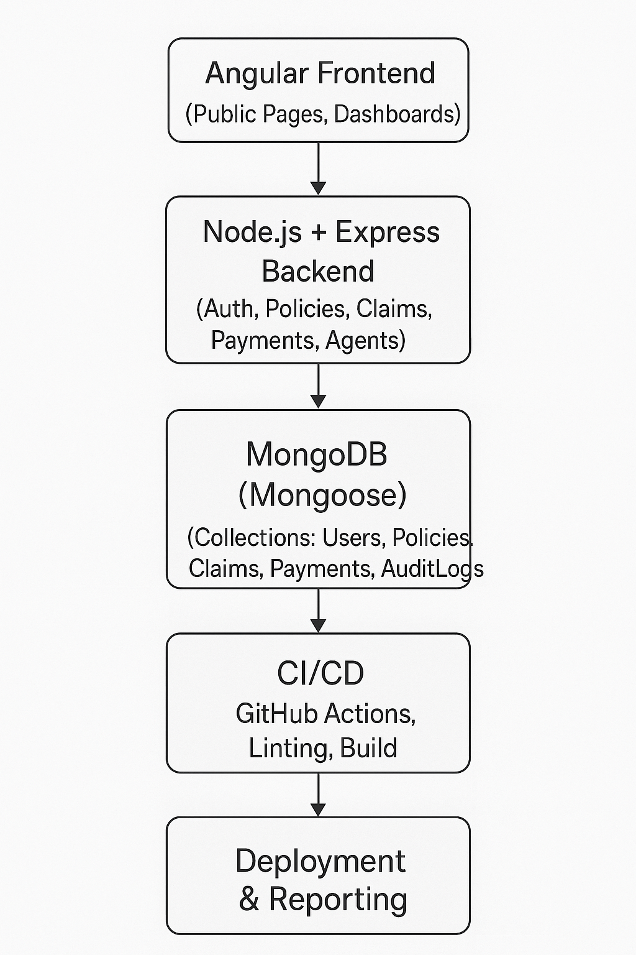

Slide 6
The project focuses on building a lightweight yet complete end-to-end system that enables customers, agents, and admins to interact seamlessly within a secure platform. Core functionalities include user authentication with role-based access, policy browsing and purchasing, claim submission and processing, and payment recording (simulated). Customers can manage their policies, submit claims and track payments, while agents and admins can oversee claims, manage agents and access audit logs and reporting. The application emphasizes a clear separation of concerns with a modular backend using Node.js, Express, MongoDB, and a responsive Angular frontend for intuitive user interactions.
The project is designed with enterprise-minded practices while staying within the MVP scope and a tight 4-day timeline. Security is enforced through JWT authentication, input validation and role-based middleware, while maintainability is ensured with a layered architecture, linting and testing pipelines. Scalability considerations include a stateless backend and indexed database queries.

Slide 7
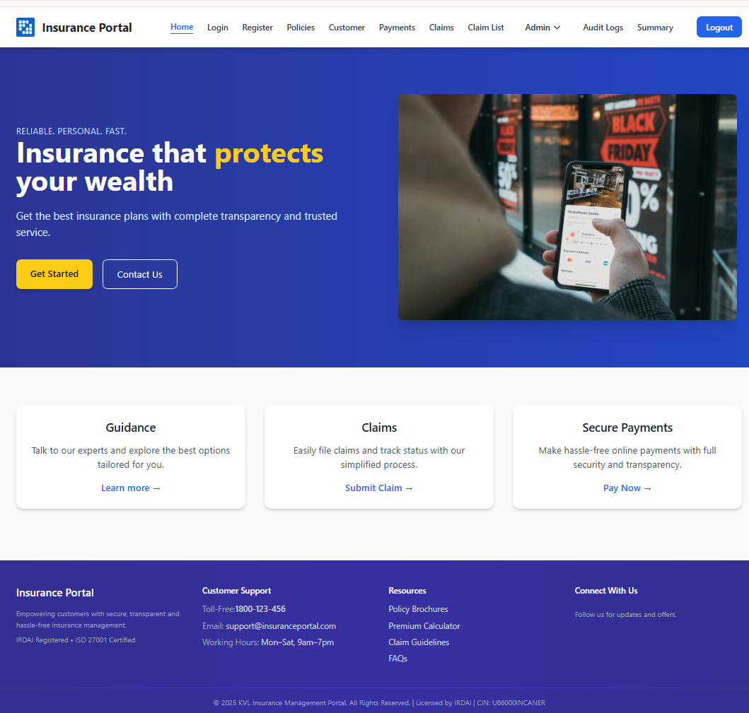
This is the Home page of the Insurance Portal application. It highlights the platform’s purpose providing secure, transparent, and fast insurance services.
The top navigation bar gives access to key modules like Policies, Payments, Claims, Customer, and Admin dashboards.
The hero section promotes insurance protection with clear CTAs like Get Started and Contact Us.
Below, three feature cards summarize core services: Guidance, Claims, and Secure Payments.
The footer includes customer support details, resources, certifications, and quick links for users.

Slide 8
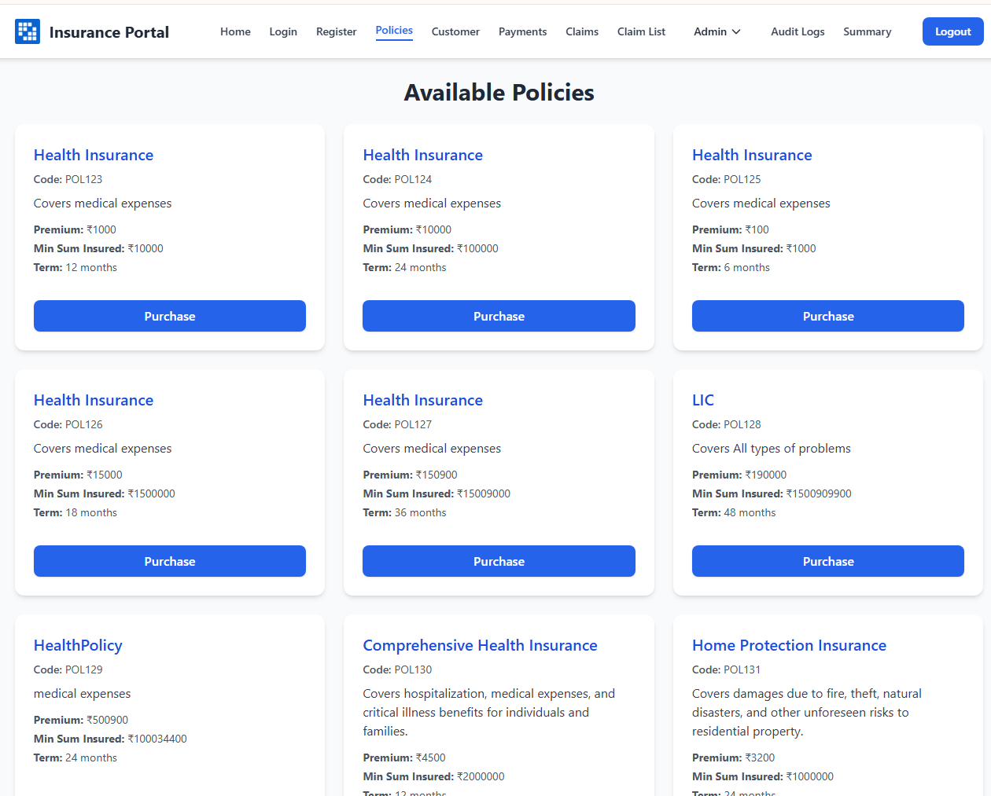
Important areas of the Project with screenshots

Slide 9
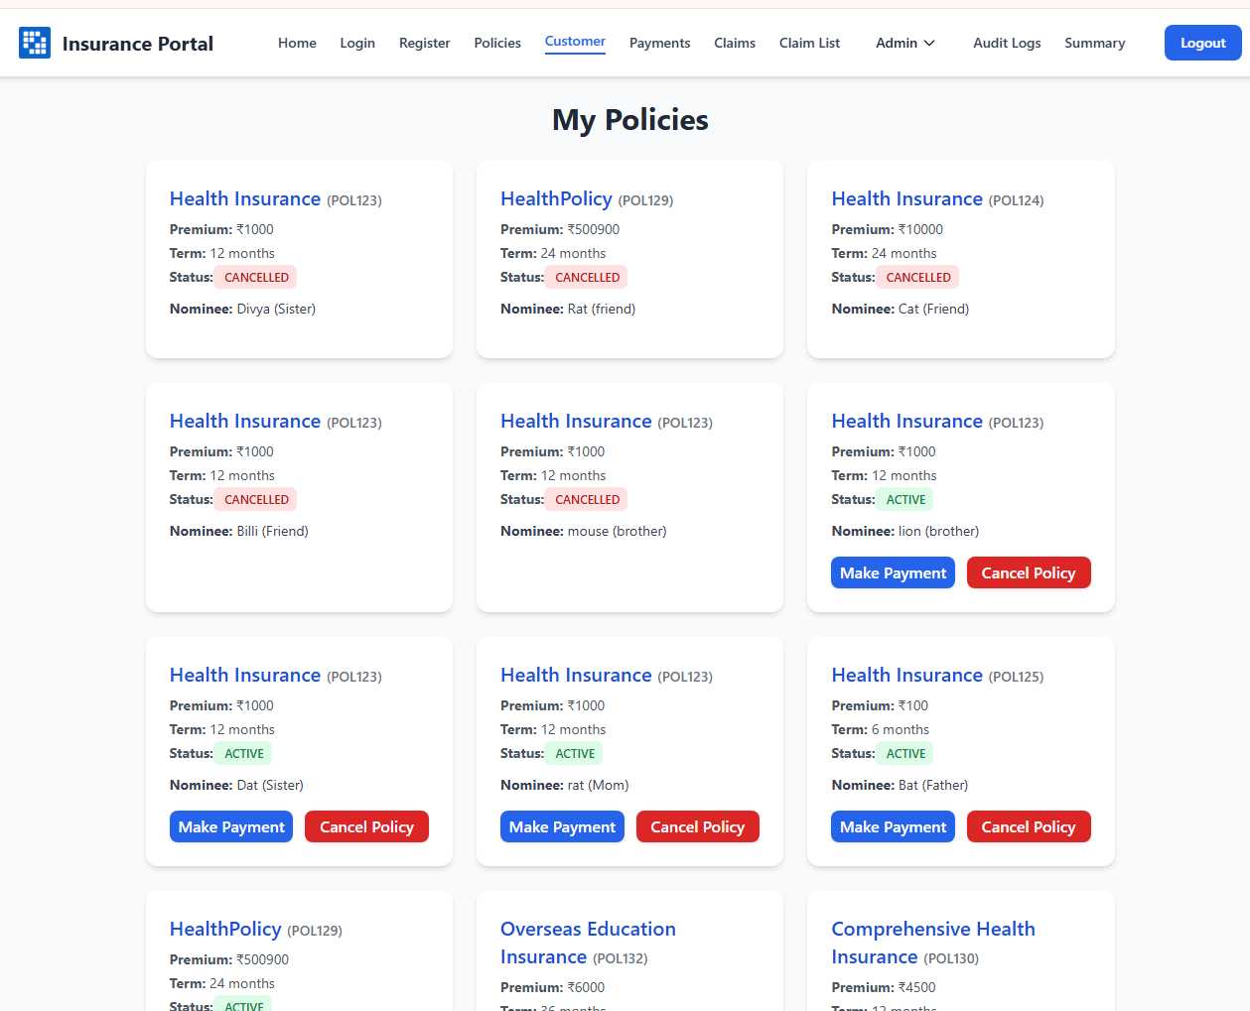
Important areas of the Project with screenshots​

Slide 10
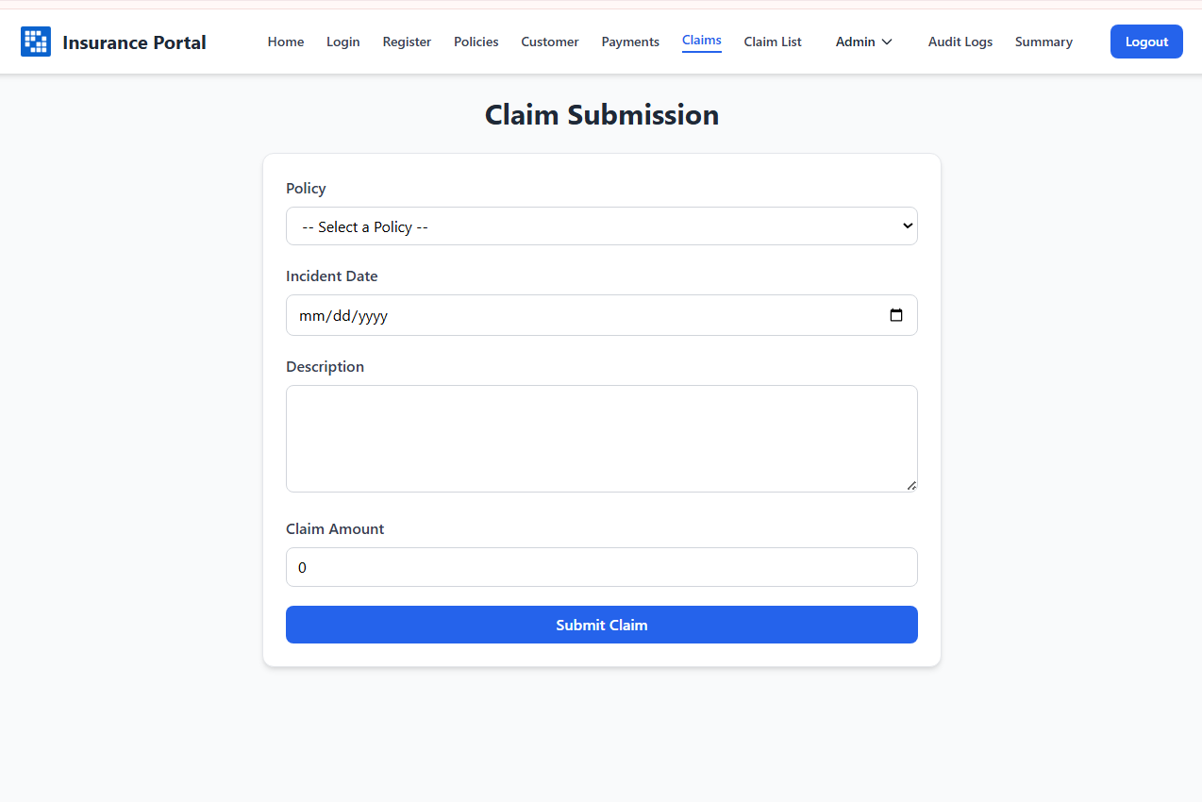
Important areas of the Project with screenshots

Slide 11
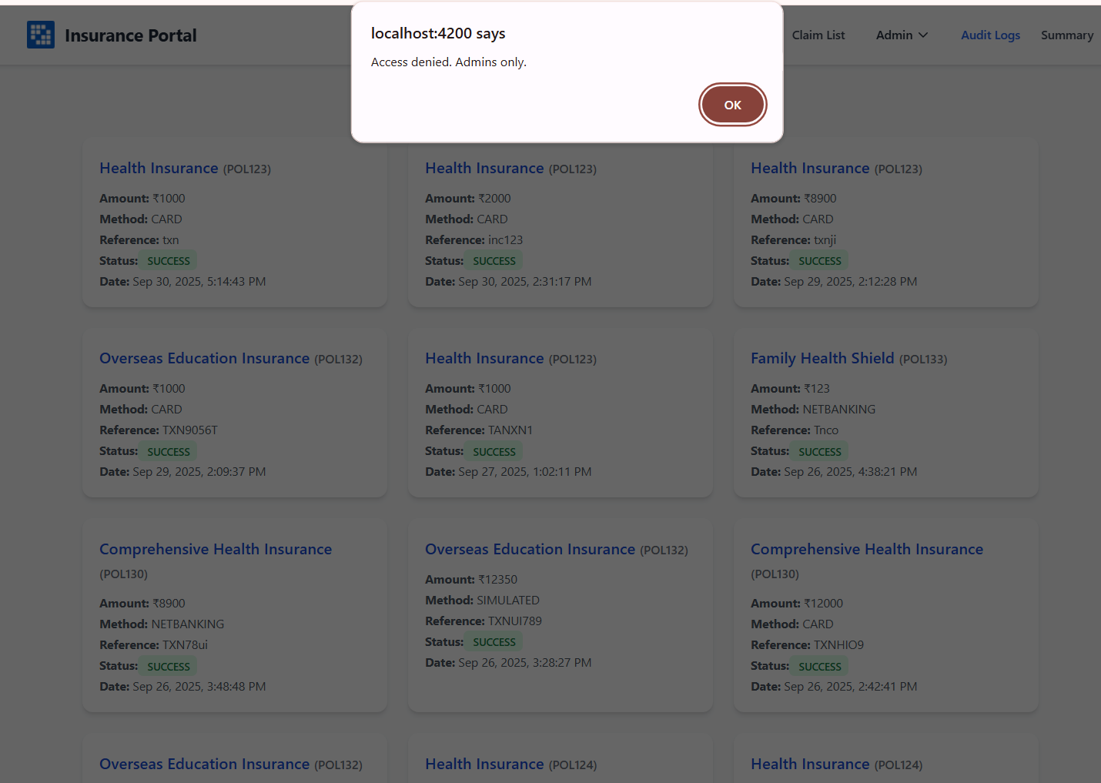
Important areas of the Project with screenshots

Slide 12
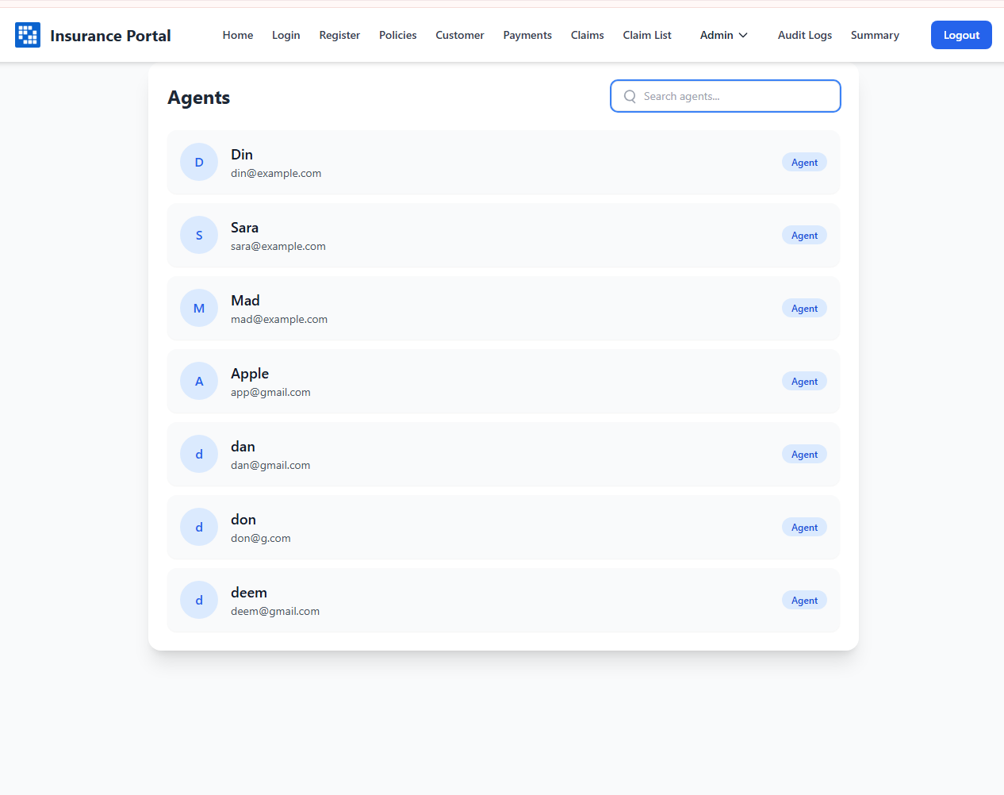
Important areas of the Project with screenshots

Slide 13
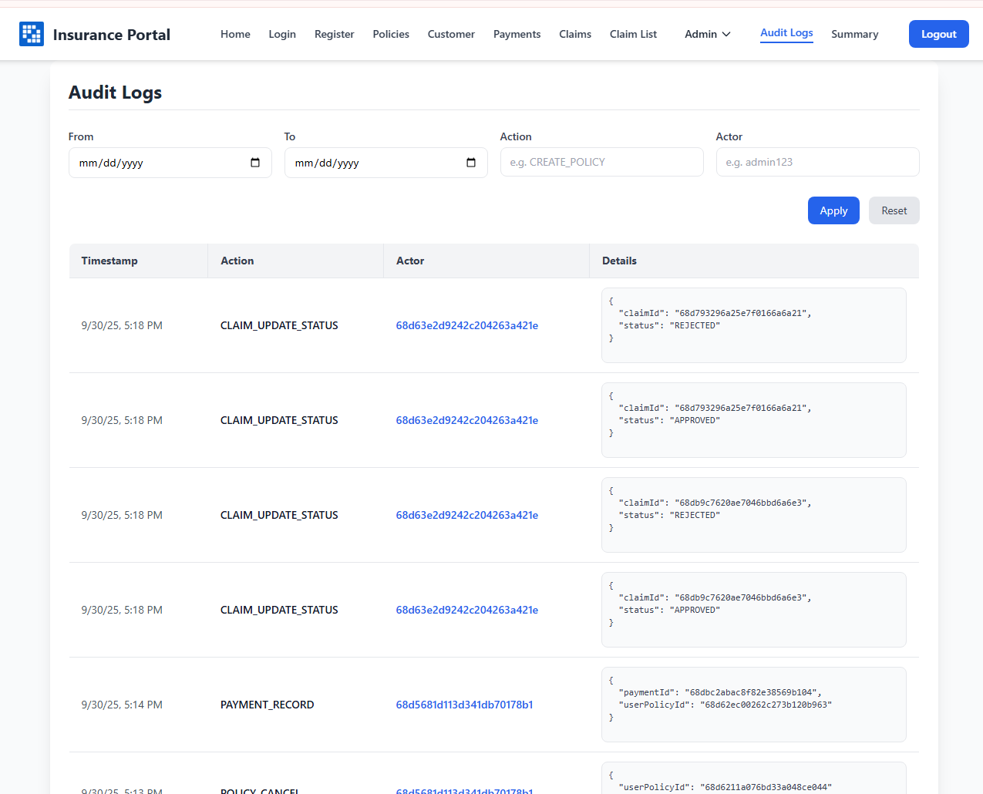
Important areas of the Project with screenshots

Slide 14
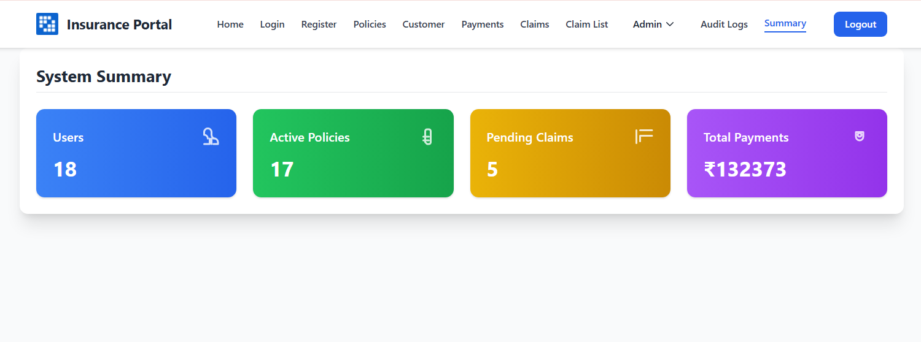
Important areas of the Project with screenshots

Slide 15
Conclusion
Complete Insurance Flow
User Features (Customer):
Register & Login: New users can create an account by providing details (name, email, password, role). After registration, they log in securely with email and password.
Policy Management: Customers can browse available policies, view details, and purchase policies by selecting term, start date, and nominee.
Claims: Customers can submit a claim for a purchased policy by giving incident details and claim amount.
Payments: Customers can record payments for their policies (dummy/simulated) and track payment history.
Dashboard: A personalized dashboard shows purchased policies, submitted claims, and payments made.
Admin Features:
User & Agent Management: Admins can create and manage agent accounts, and view the list of all users.
Policy Oversight: Admins can track how many policies are sold, cancelled, or active.
Claim Supervision: Admins can view all claims and approve or reject them (along with agents).
Agent Assignment: Admins can assign agents to policies or claims for better workload distribution.
Audit & Reports: Admins can monitor activities, view audit logs, and get summary reports (e.g., total users, claims pending, payments collected).

Slide 16
Conclusion
Secure System
Login and access control with different roles (Customer, Agent, Admin) to protect data.
Modern Technology
Built with Angular (frontend), Node.js/Express (backend), and MongoDB (database).
Easy to Maintain
Clean and well-structured code that can be easily updated or extended.
User-Friendly Interface
Simple, responsive design for customers, agents, and admins to use without confusion.
Payments Simplified
Payment recording is included (simulated, no real gateway) for easy testing and flow coverage.
Tracking & Reports
Audit logs and summary reports give admins clear insights into policies, claims, and payments.
Tested for Quality
Key features tested using unit tests and Postman to ensure reliability.
MVP Ready
All core features are working: user login, policy purchase, claim submission, payments, and admin management.

Slide 17

Thank You

